Slide 1
Car Accident Severity Classification
Sreeja P Sreenivasan

Slide 2
QUESTIONS ASKED
Q1: Can we predict severity of car accidents?
Q2: What kind of accidents occurred whether it was only damage to property or damage to passengers as well.

Slide 3
Data
Detailed road safety data about the circumstances of personal injury road accidents in UK in 2018, published by central government of UK.
TARGET Variable: Accident_Severity (Slight, Serious, Fatal)
FEATURES: More than 30 variables, describing Types and Number of people and vehicles involved, Road & Weather Conditions, and what kind of accident had occurred etc.
Source: https://s3.us.cloud-object-storage.appdomain.cloud/cf-courses-data/CognitiveClass/DP07 01EN/version-2/Data-Collisions.csv.

Slide 4
Exploratory Data Analysis
Preliminary EDA showed:
Presence of TARGET Variable imbalance problem
Important data missing in TARGET variable
Visualisation: high impact of some FEATURES: severity code against its frequency,collision code and the frequency

Slide 5
Data cleaning and Feature Engineering
Dropped missing values
Removed highly correlated variable
Combined columns into one due to presence of significant imbalance and to simplify classification
Applied different types of re sampling to avoid highly unbalanced data problem

Slide 6
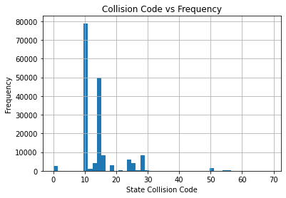
Collision code and Frequency
Collision code and the frequency.
This graph plots the amount of a specific collision code. The collision code is more specific, stating that the collision of code 10 or 11, which is either “entering at an angle” or “both going straight, both moving, sideswipe” was the highest among the rest.

Slide 7
The last two graphs plotted were scatter plots of damage
only to property and a collision involving human injuries
taking into account the number of people and vehicles
involved. Looking below we see that property damage
accidents mostly involve two or more vehicles and
multiple people.

Slide 8
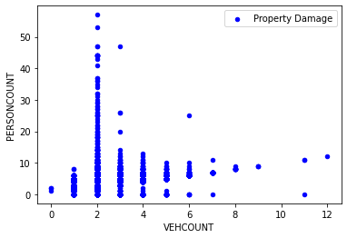
Property Damage

Slide 9
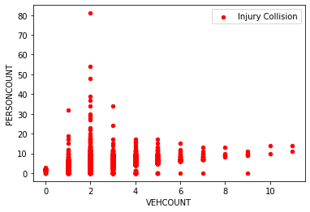
Injury collision

